Slide 1

Project Kindle
(unemployed title)
By: Isaiah Hull

Slide 2

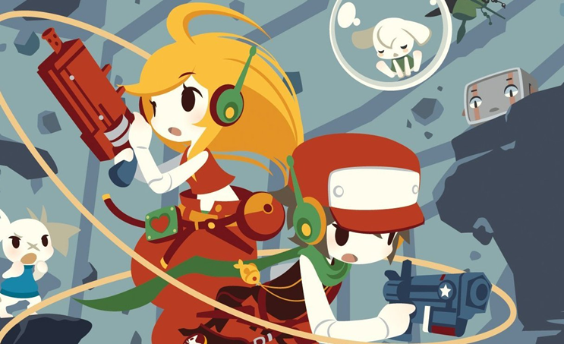
About me
I like Cave Story

Slide 3

About me
I like Cave Story
Messed with Game Development for 6+ years
Programming is strongest skill

Slide 4
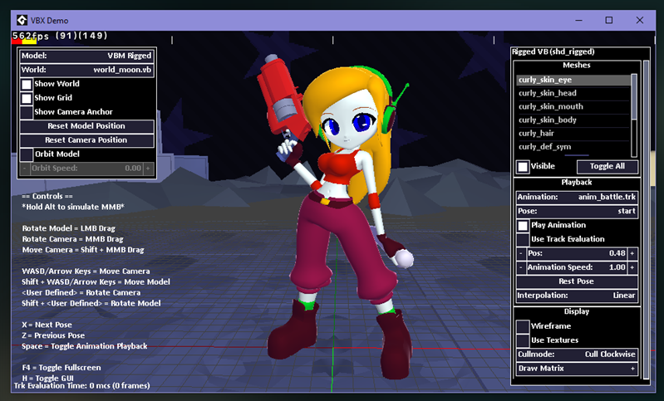
About me
I like Cave Story
Messed with Game Development for 6+ years
Programming is strongest skill
Wrote a model exporter for Blender to GMS2 over semester break

Slide 5
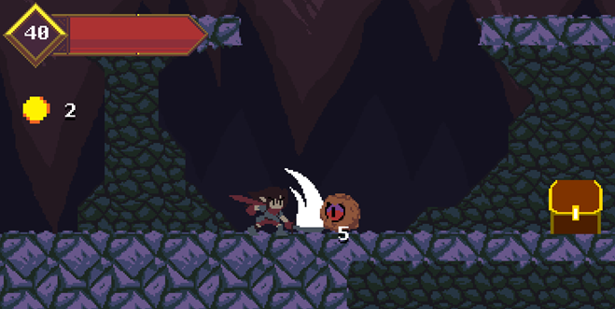
About me
I like Cave Story
Messed with Game Development for 6+ years
Programming is strongest skill
Wrote a model exporter for Blender to GMS2 over semester break
Worked on Hunter for Game Dev Club

Slide 6
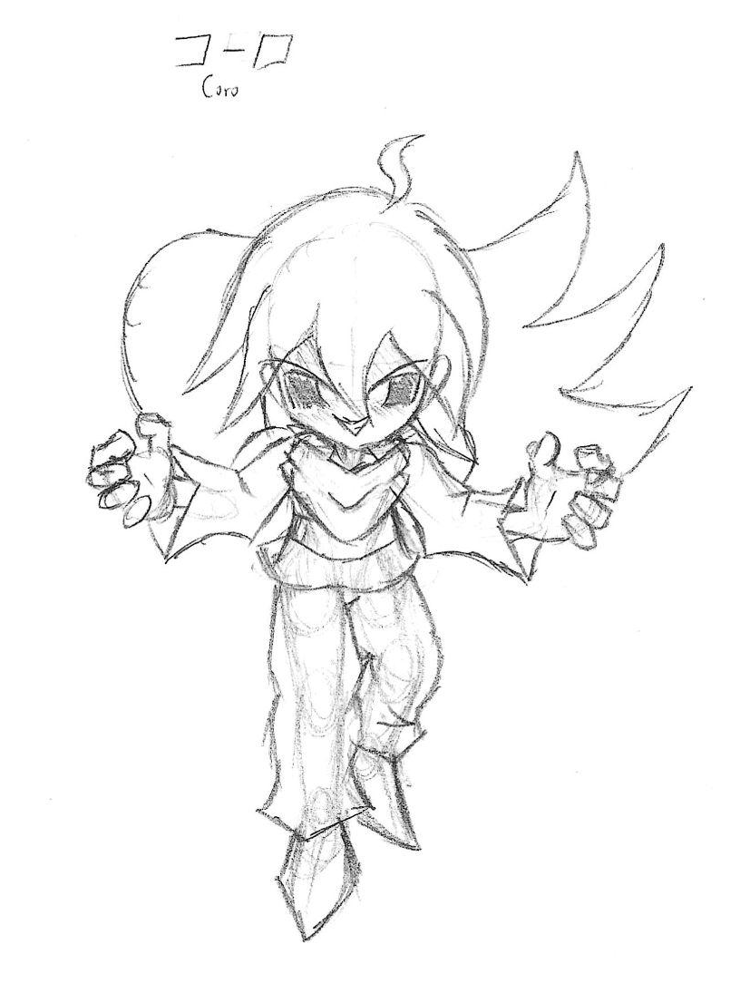
Game Premise (1)
A human named Coro, falls asleep and enters the Dream World. Coro has been blessed with the power to make his dreams come true. This power came with the expectation that the wielder would do good, but Coro wants to cause chaos and destruction instead.

Slide 7
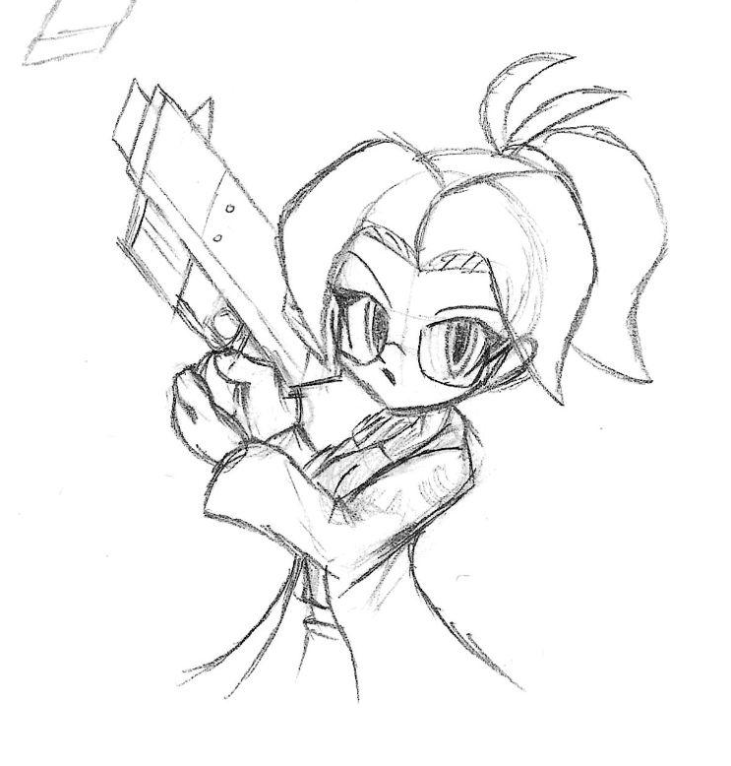
Game Premise (2)
He wakes up an entity called the Onyx and releases monsters onto the world. The Onyx reaches the residence of a robot scientist named Kindle. She decides to fight against the Onyx and save the Dream World from doom.

Slide 8
Controls
Move with left and right
Aim with left, right, up, and down
Shoot with SHOOT button
Jump with JUMP button

Slide 9
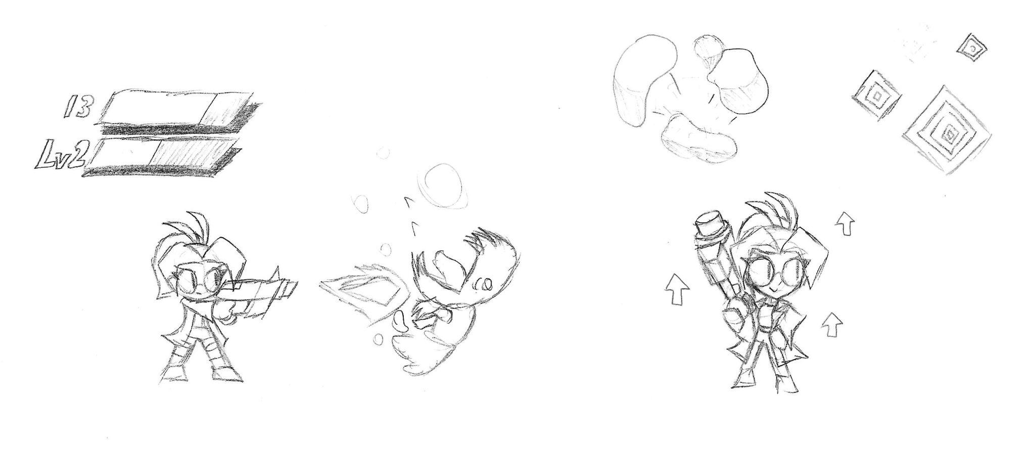
Mechanics
Most enemies deal contact damage
When defeated, enemies drop health or energy
Energy is used to level up weapons to increase their power
If Kindle takes damage, she loses energy which can downgrade weapons

Slide 10
Semester Plans
Banjo Kazooie-like philosophy
One area with objectives and rewards
Weapons, health boosts, items, quick travel?
Boss can be fought…
At any time
Once a certain objective is done
Player can grow their strength or challenge themselves early

Slide 11
Why this project?
Simple, lax project
“Dream” theme means anything is fair game
Small enough for a starter project, big enough for content
Mechanics are important
Opportunity to practice designing comfortable controls for a platformer

Slide 12
That’s all
Thanks for your time

